Slide 1

Welcome
JOHN F KENNEDY
SIXTH FORM
Year 13 Information evening
Progress score
Outperformed 75% of schools in Hertfordshire
Inspire | Achieve | Serve
Progress score

Slide 2
JOHN F KENNEDY
SIXTH FORM
Mr Joyce - Mr Wainman - Mrs Whittaker - Ms Jenkins - Mrs Powell - | Director of Sixth Form Assistant Director of Sixth Form Sixth Form Achievement Assistant Careers Lead Librarian
Progress score
Outperformed 75% of schools in Hertfordshire
Inspire | Achieve | Serve
Progress score

Slide 3



JOHN F KENNEDY
SIXTH FORM
HIGHEST PERFORMING CATHOLIC SCHOOL SIXTH FORM IN HERTFORDSHIRE
SIXTH FORMERS WENT ONTO FURTHER EDUCATION OR EMPLOYMENT
Progress score
Progress score
RETENTION RATE
Outperformed 75% of schools in Hertfordshire
THERE IS ALWAYS SUPPORT AVAILABLE; PERSONALLY, I FEEL AS THOUGH I HAVE DEVELOPED A GREAT RAPPORT WITH MY TEACHERS WHICH HAS HELPED ME THROUGH MY SIXTH FORM JOURNEY.
0.2
A* - C IN 2024
A* - A IN 2024
PERFORMANCE SCORE
Inspire | Achieve | Serve

Slide 4
Key events of Year 13
Wednesday 10th September - Information Evening Webinar
UCAS Conservatoire Early Entry Deadline: Thursday 2nd October
UCAS Early Entry Deadline: 15/16th October
Parent Consultation Evening: Thursday 23rd October
Mock Exams: Monday 24th November to Friday 5th December
UCAS Internal deadline: 9th December
Mock exam results: sent home by 19th January
A Level Exams: 11th May - 23rd June (TBC)
A Level Results Day: 20th August (TBC)

Slide 5
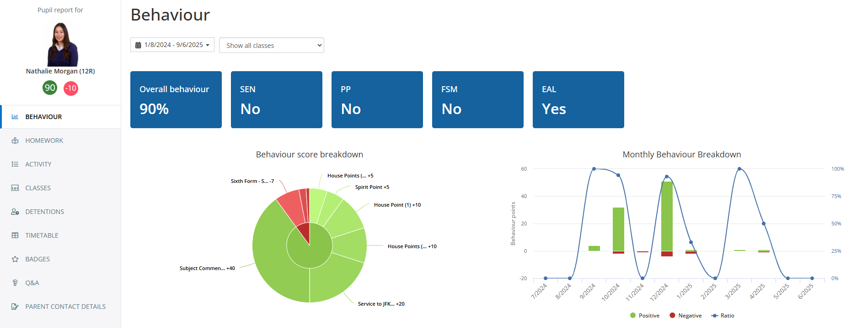
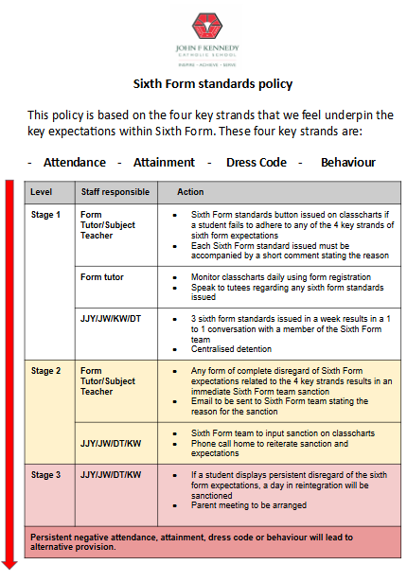
JOHN F KENNEDY
SIXTH FORM
Mrs Whittaker - Focus on Attendance:
Daily registers
Daily meetings with specific targeted students
Contact with home
Close eye on back to back days missed
Sheet comparison shared with Mr Joyce, Mr Wainman and form tutors
Progress score
Outperformed 75% of schools in Hertfordshire
Inspire | Achieve | Serve
Progress score

Slide 6
Form Tutor Time
Monday | Tuesday | Wednesday | Thursday | Friday
Organisation | Self-Appraisal / Briefing | Futures | Assembly | Current Affairs
Students are to organise and prepare for: Lessons Study Periods Directed Study Supercurricular Extracurricular Home Learning | Students to set up appointments with form tutor for 1-1 support Key messages shared during a briefing by The Sixth Form Team | Sessions delivered by form tutor on topics related to life skills, personal development and preparation for life beyond Sixth Form. | Staff led assembly | Students will engage in wider reading, discussion and debate on current world affairs, such as politics and news.
All Sixth Form students are expected to attend registration at 8:50 in the morning with their form tutor.
During lunch time, students are allowed to leave the school site, but must return to school for Period 5.
Due to less contact time in Sixth Form, students will have some private study time, where they must be using the study areas productively to complete any home learning or Supercurricular activities.

Slide 7
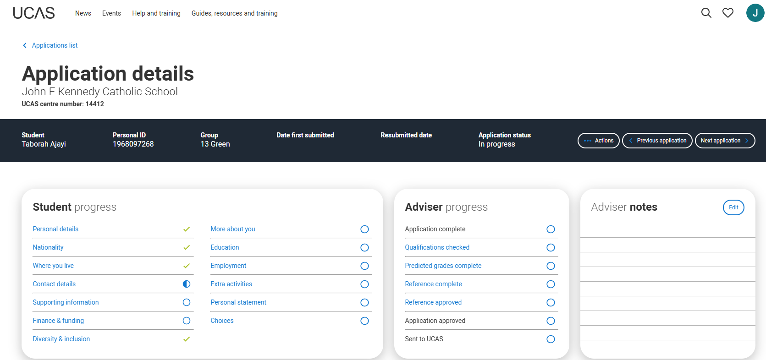
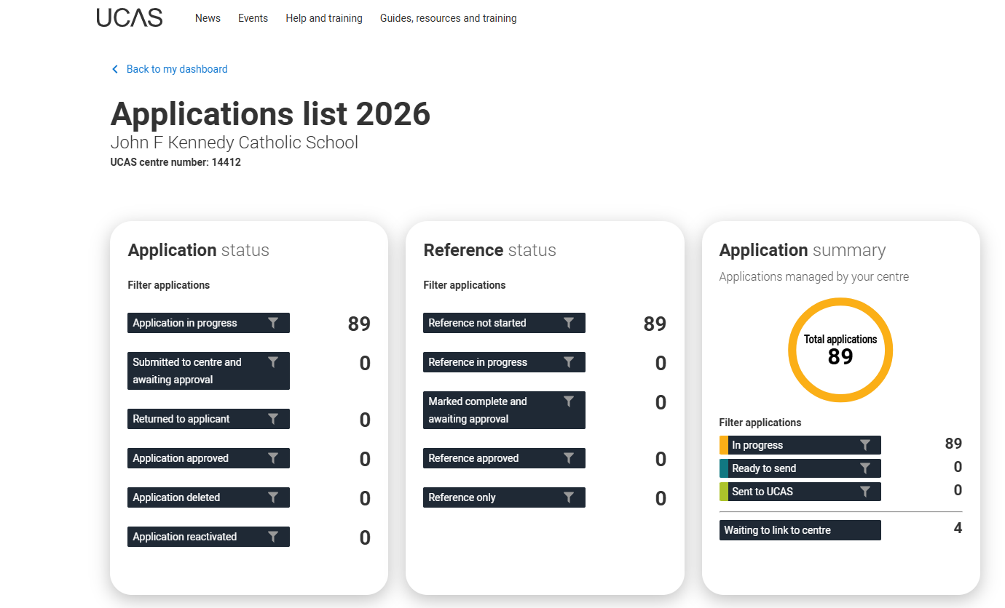
JOHN F KENNEDY
SIXTH FORM
UCAS application and support
Progress score
Outperformed 75% of schools in Hertfordshire
Inspire | Achieve | Serve
Progress score

Slide 8

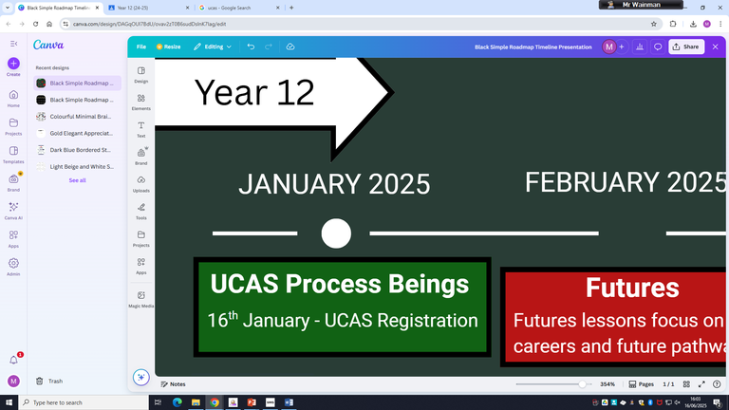

JFK TIMELINE
Personal Statement Planning Begins
25th June - Personal Statement planning during Futures
End of academic year - Early Entry/Oxbridge Personal Statements are handed in for first draft
Year 12
JANUARY 2025
FEBRUARY 2025
MARCH 2025
APRIL 2025
MAY 2025
JUNE 2025
JULY 2025
UCAS Process Beings
Futures
UCAS Exhibition
Destinations
Destinations Completed
6th January - UCAS Registration
Futures lessons focus on careers and future pathways
12th May - Students are given a destinations document to begin filling out university/ apprenticeship choices
13th May - UCAS Hub Opens
12th June - Student destinations document returned
19th March - Excel Centre London
AUGUST 2025
MARCH 2026
FEBRUARY 2026
JANUARY 2026
DECEMBER 2025
NOVEMBER 2025
OCTOBER 2025
SEPTEMBER 2025
Year 13
UCAS Extra Opens
UCAS Deadline
Internal Application Deadline
26th February
For equal considerations - submit by 14th January
9th December
Personal Statement Draft
7th October - Personal Statement Draft Due
2nd October - Conservatoire Deadline
15th October - Early Entry/Oxbridge Deadline
References
APRIL 2026
Subject References completed for whole cohort
7th September - Early Entry/Oxbridge First Draft Personal Statement Due
MAY 2026
JUNE 2026
JULY 2026
AUGUST 2026
University Confirmation
Clearing Opens
3rd June - Students to confirm their firm and insurance choices
Results Day
5th July
13th August

Slide 9
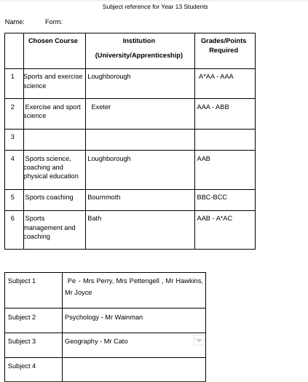
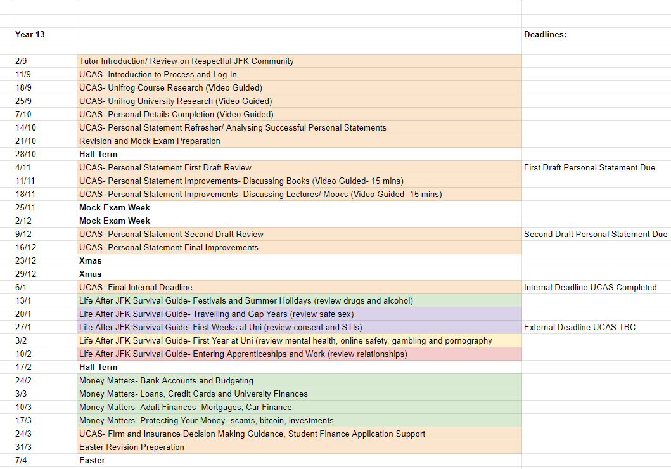
UCAS Support

Slide 10
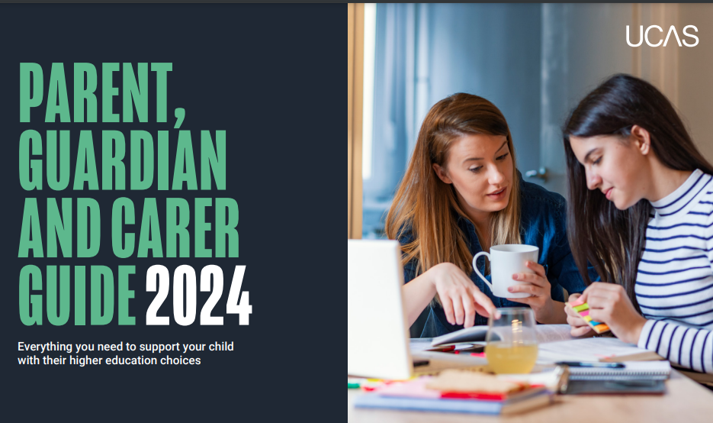


UCAS Support

Slide 11
How can you support them?
Research
Use the parents/guardians’ section of the UCAS website at www.ucas.com/parents.
Sign up
Sign up for parent updates from UCAS and get everything you need to know about the application process direct to your inbox.
Open days
Attend virtual events and open days – you may have a different perspective.
Be proactive
Make sure they read everything carefully that is sent to them and don’t book holidays at key times!

Slide 12

All students can choose up to 5 courses /universities, Ideally:
1. Aspirational
2. Aspirational/Realistic
3. Realistic
4. Realistic
5. Insurance

Slide 13
Attendance
Is 95% attendance good?
This means that your child has still missed nearly 10 school days in one year.
Over five years that would be nearly 50 days, this is almost a school term
Achievement, wellbeing and development
Research confirms that there is a strong link between absence and underperformance at the end of key stage

Slide 14

16- Bursary Fund/Support
If your financial situation has changed since last year, please contact us
Parents/Carers can still apply
Forms are on the school website
More information available through the Sixth Form team

Slide 15
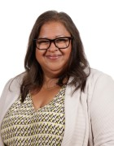
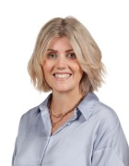
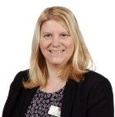
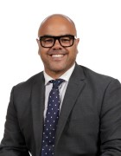
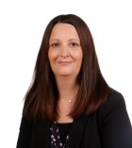
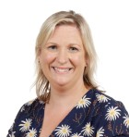
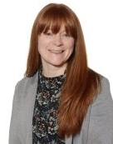
Worried?
Problem?
We can help!
The Safeguarding Team
SPEAK
SHARE
SOLVE
Mrs Jevon
Miss Freed
Mrs Whittaker
Mr Palumbo
Form Tutor
Any
Trusted
Adult
Mrs McKenzie
Member of Achievement
Team
Email staysafe@jfk. herts.sch.uk
Mrs Holton
Mrs Bailey
Help us to make sure everyone is safe and able to flourish
Notes:
Introduce who the safeguarding team are to students

Slide 16

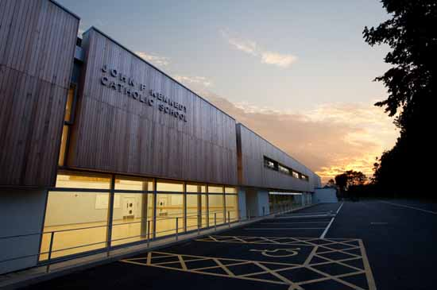



JOHN F KENNEDY
SIXTH FORM
Academic Culture
How can you support?
Inspire | Achieve | Serve

Slide 17
JOHN F KENNEDY
SIXTH FORM
Early Entry Applications
-Medicine
-Dentistry
-Veterinary Science
Oxford and Cambridge University
Ensure your child is receiving the support we have on offer…
Regular check-ins (Mr Wainman & Form Tutor)
Personal statement guidance
Admissions preparation
Interview practice
Wellbeing and workload!
UCAS Deadline: 15th October 2025
Inspire | Achieve | Serve

Slide 18
JOHN F KENNEDY
SIXTH FORM
Independent Study
Making the most of their independent study time
“Directed Study” - Twice a week
Equipment, Folders, Textbooks
Inspire | Achieve | Serve

Slide 19
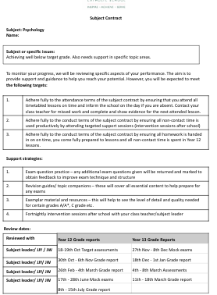
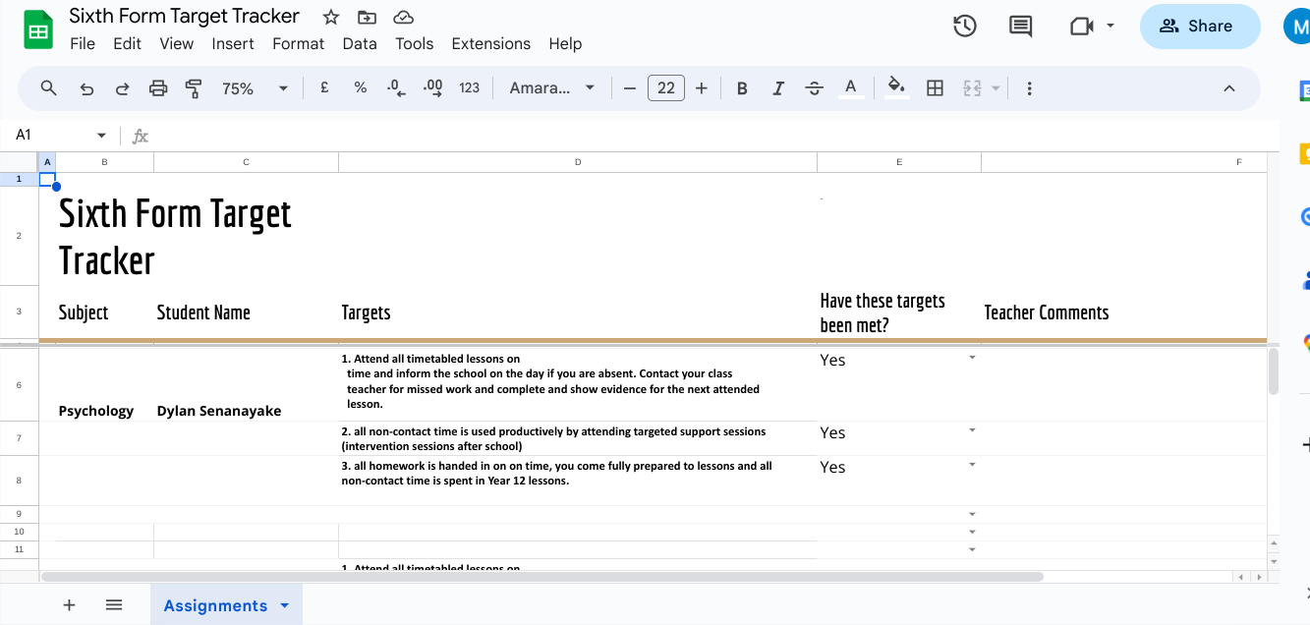
JOHN F KENNEDY
SIXTH FORM
Raising Attainment - Subject Contract and Tracking System
Inspire | Achieve | Serve

Slide 20
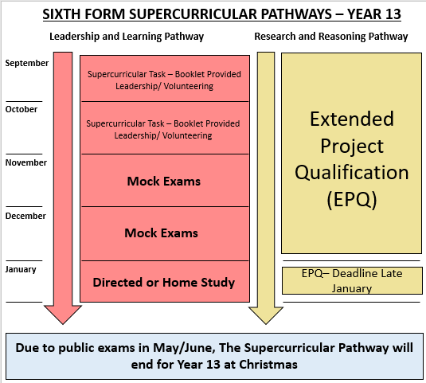
Volunteering & Supercurricular
Helps with personal statement and applications to universities/apprenticeship or work
Ends at Christmas so Year 13 students encouraged to make the most of this opportunity
Extended Project Qualification (EPQ)
MOOCS and online courses
Online lectures/talks
Reading books
Essay/Project competitions
Discussions with other students (e.g. medicine society)
Silver
Bronze
Gold
Inspire | Achieve | Serve

Slide 21











JOHN F KENNEDY
SIXTH FORM
Enrichment Programme brings Year 12 and 13 together for talks that go beyond the A-Level curriculum.
Sessions support future pathways, offering insights into university, apprenticeships, careers, and key skills.
‘JFK University Showcase Event’
Inspire | Achieve | Serve

Slide 22
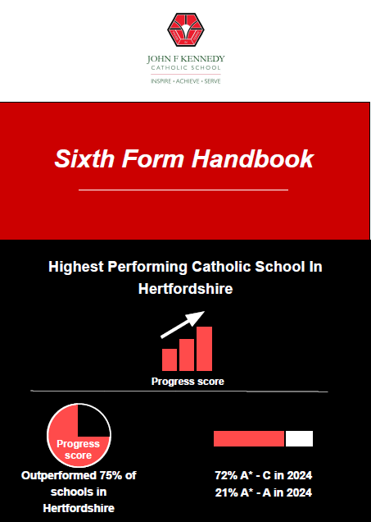
JFK Sixth Form Handbook
1. Headteacher’s Welcome
2. Director and Assistant Director of Sixth Form Welcome
3. Introducing The Sixth Form Team
4. Student Leadership Team
5. Sixth Form Timetable
6. Standards Policy
7. Dress Code
8. Sixth Form Spaces & Mobile Phone Use
9 - 10. List of Post-16 Subjects, Grade Criteria & Option Blocks
11. UCAS & Post-18 Options
12. Enrichment
13 - 14. Supercurricular and Volunteering Programme
15. Futures Programme
16. Core RE Curriculum
17 – 18. Sixth Form Agreement

Slide 23

THANK YOU.

